Slide 1
Todo & Links
Carbon

Slide 2
Kotlin Symbol Processing in Action

Slide 3
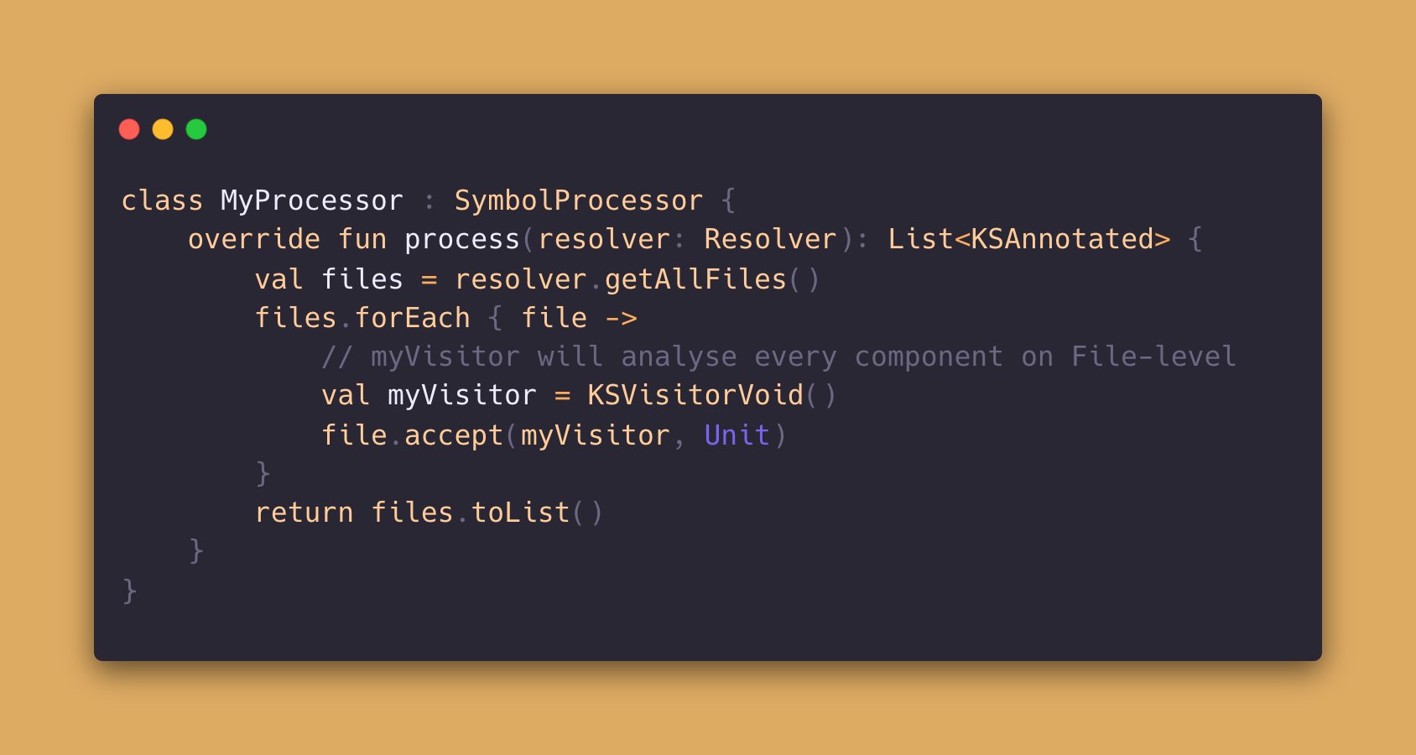
Kotlin Symbol Processor
Notes:
Firstly a few basics must be covered.
Any Processor gets a resolver passed and that resolver can be used to walk through all files of the current project/module.
Here is a small example how this can look like.
The Visitor implementation is the key to access each class and its properties and functions.

Slide 4
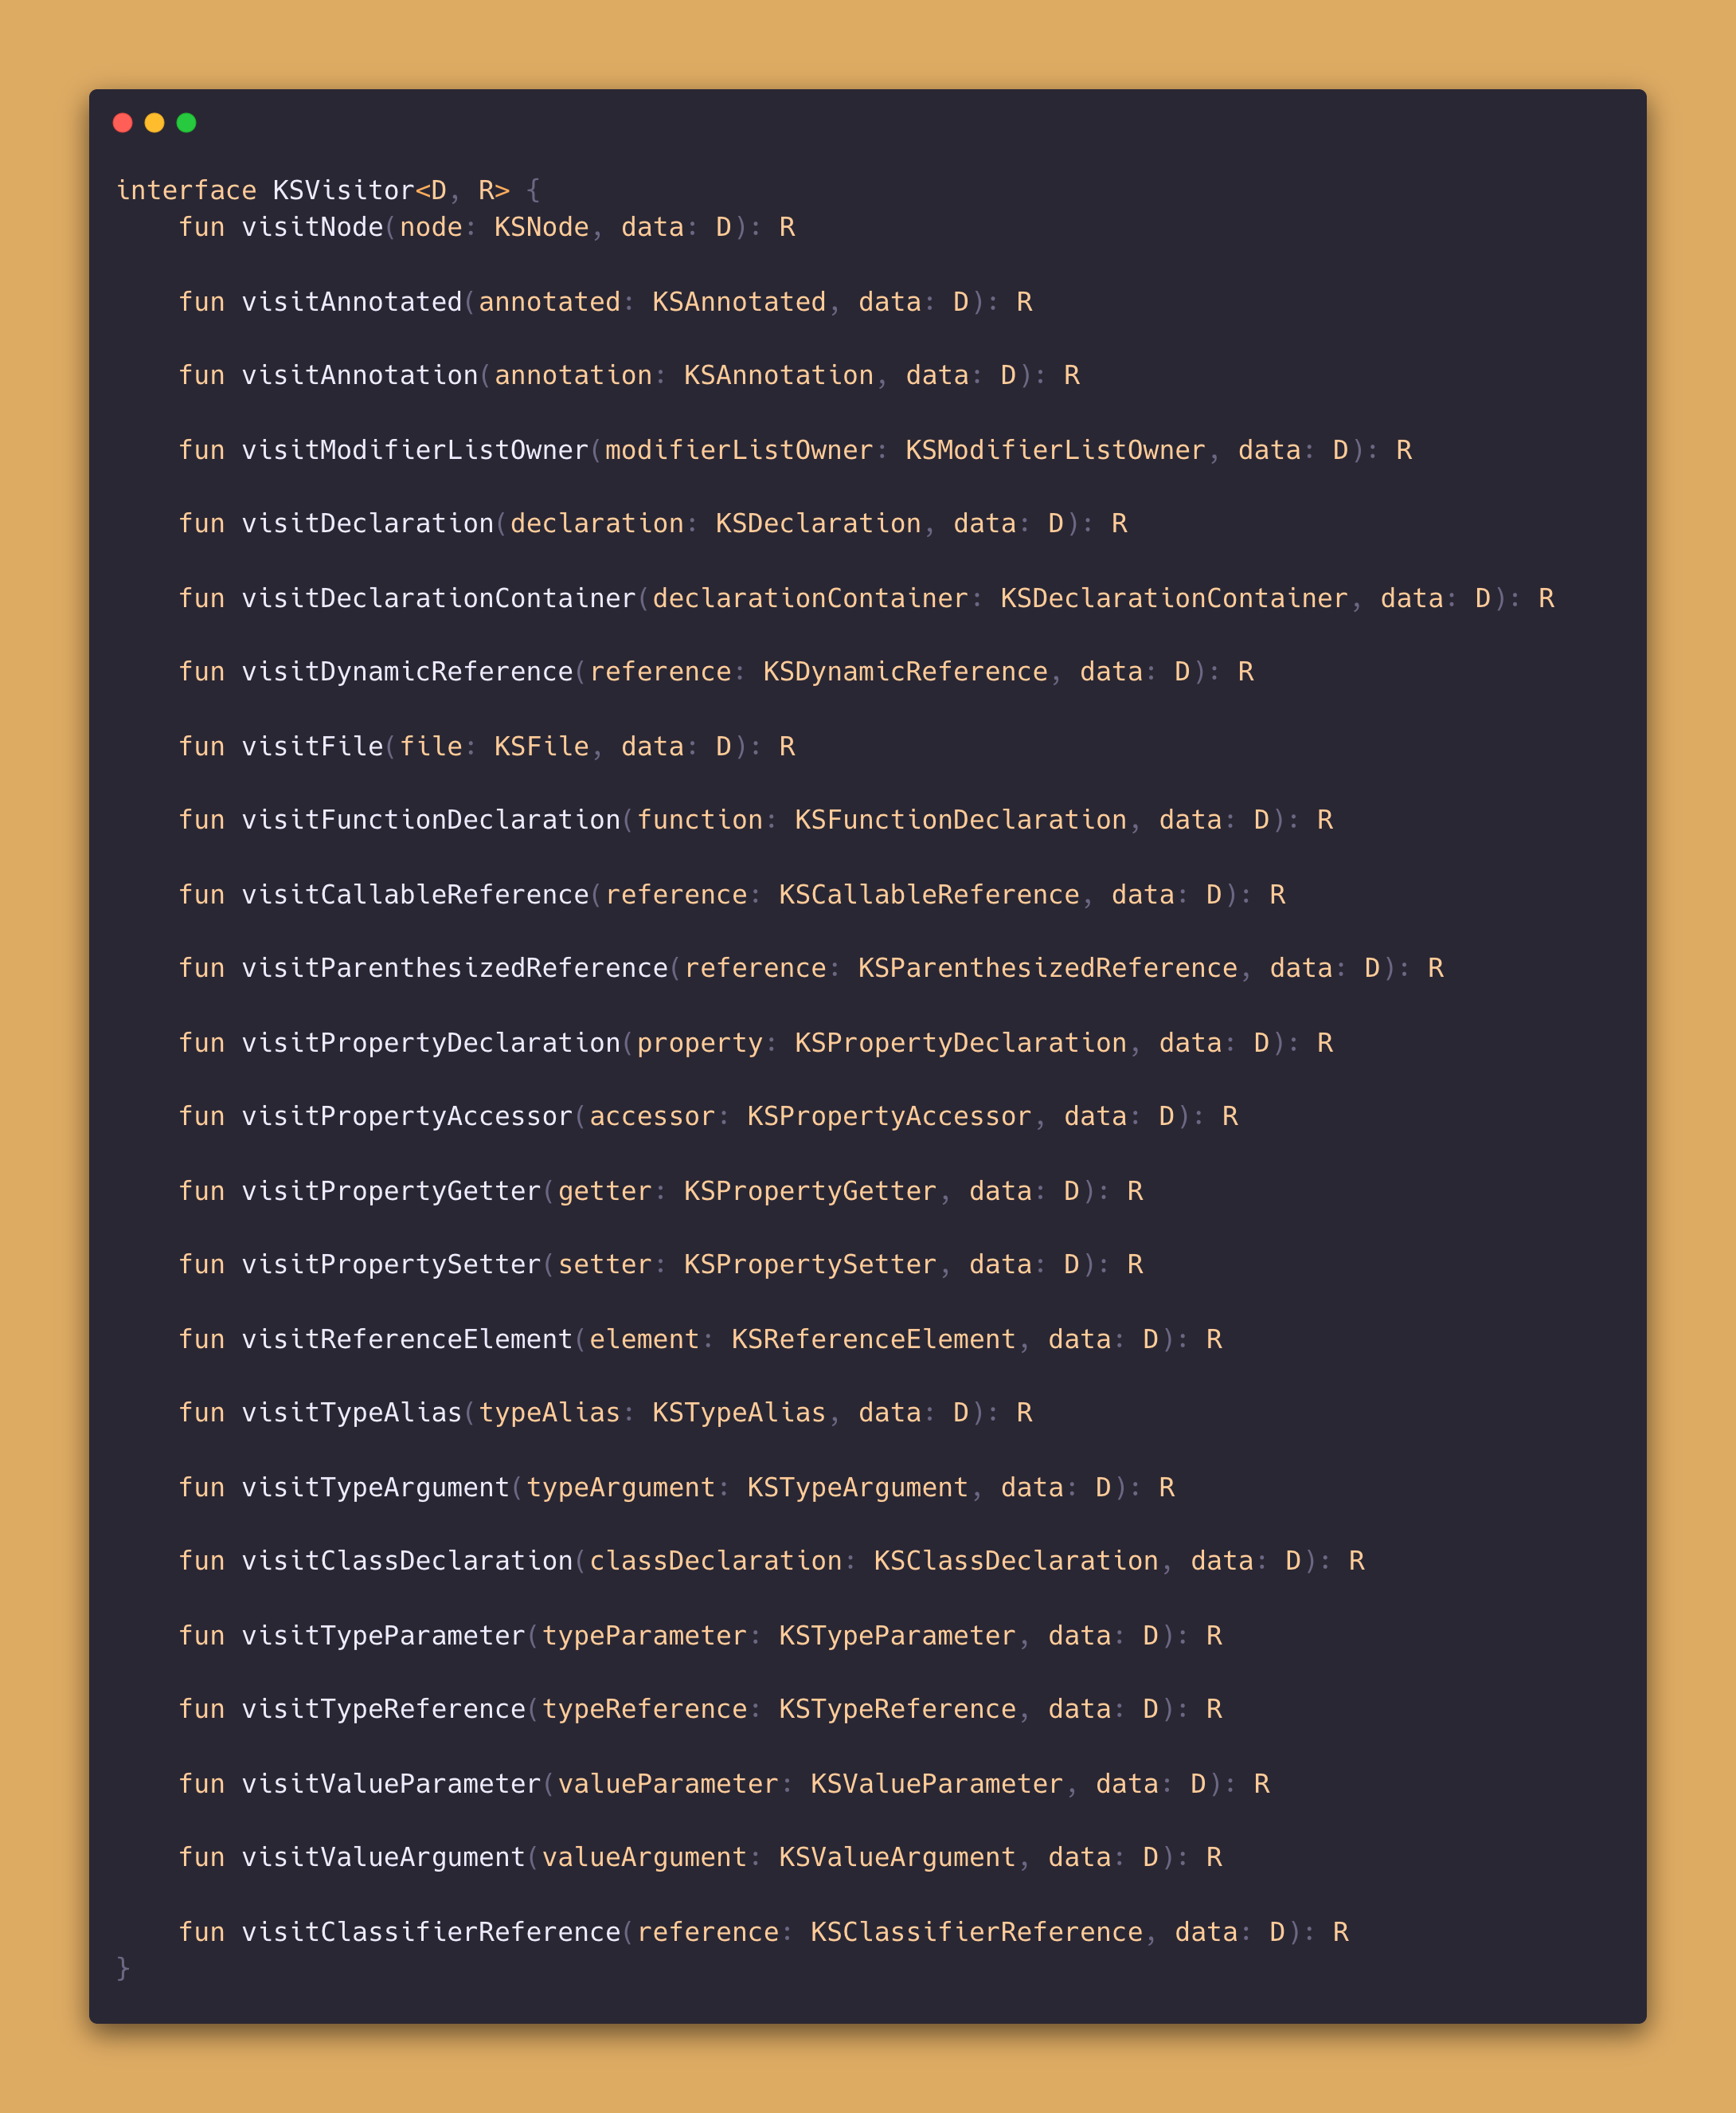
KSVisitor Complete
Notes:
KSVisitor is quite extensive.
For my implementation I just focused on a few of them.

Slide 5
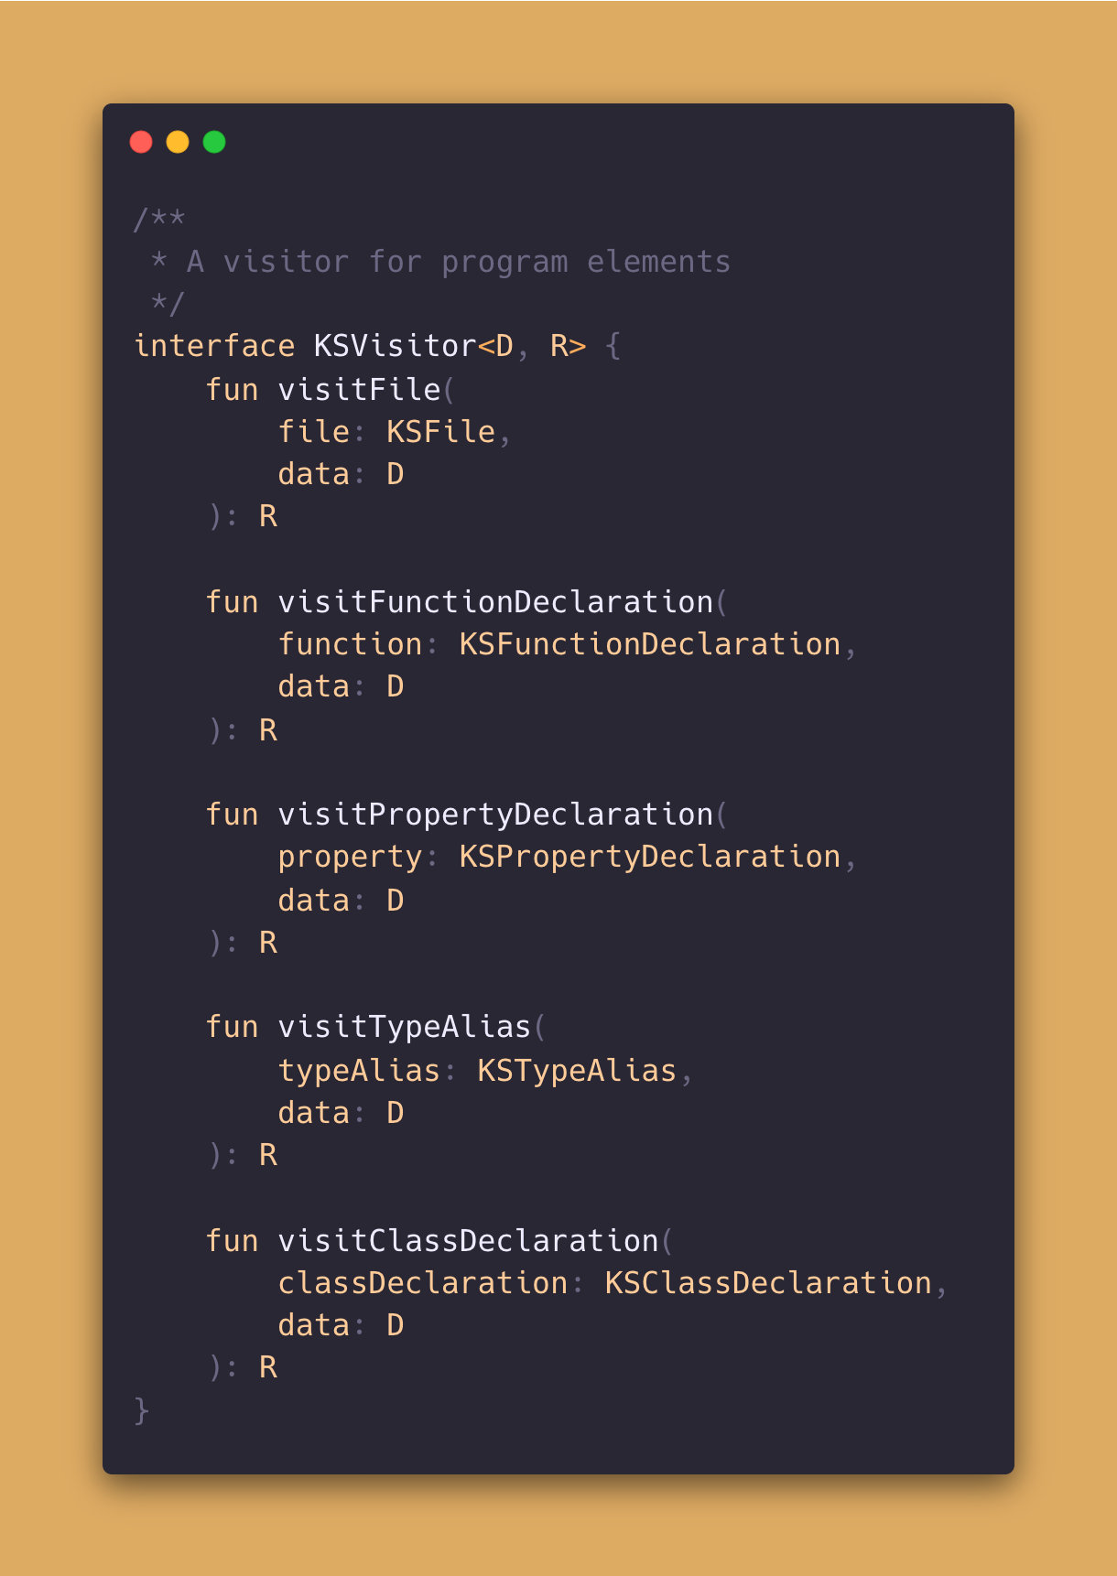
KSVisitor Focused
Notes:
When the KSVisitor is passed to a file.accept function (Like I did 2 slides before), the KSVisitor.visitFile metohd will be invoked.
All declarations that are present in a KSFile can be analysed.
Since for my Plantuml Generator its crucial to find the Functions, Properties, Classes and TypeAlias, I focused on them. Anyway its good to know all the other declarations as well.
What follows now, is a small story between a stakeholder and his colleague.

Slide 6

Ok.
We will do that internally and you can just start/stop it.
We need a Server that can handle Requests and send Responses.

Slide 7
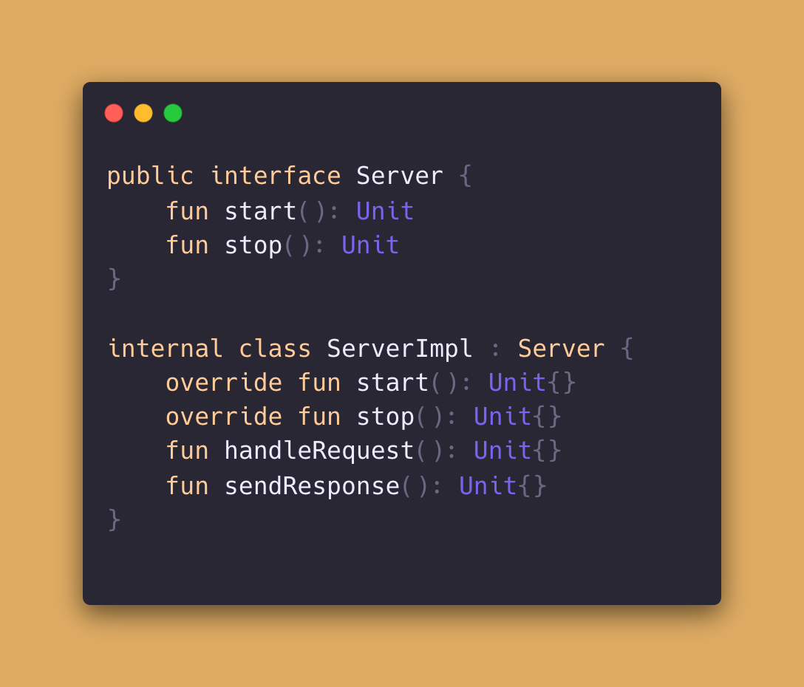
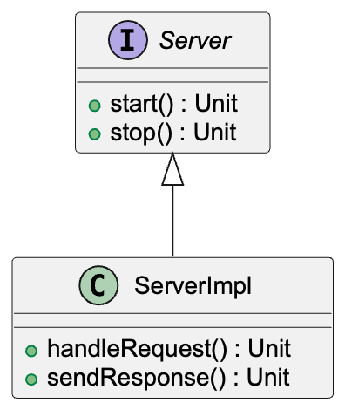
Notes:
How could we identify the Functions of the Server to draw the Plantuml diagram ?
Simply by checking its KSClassDeclarations. Lets have a look on this.

Slide 8
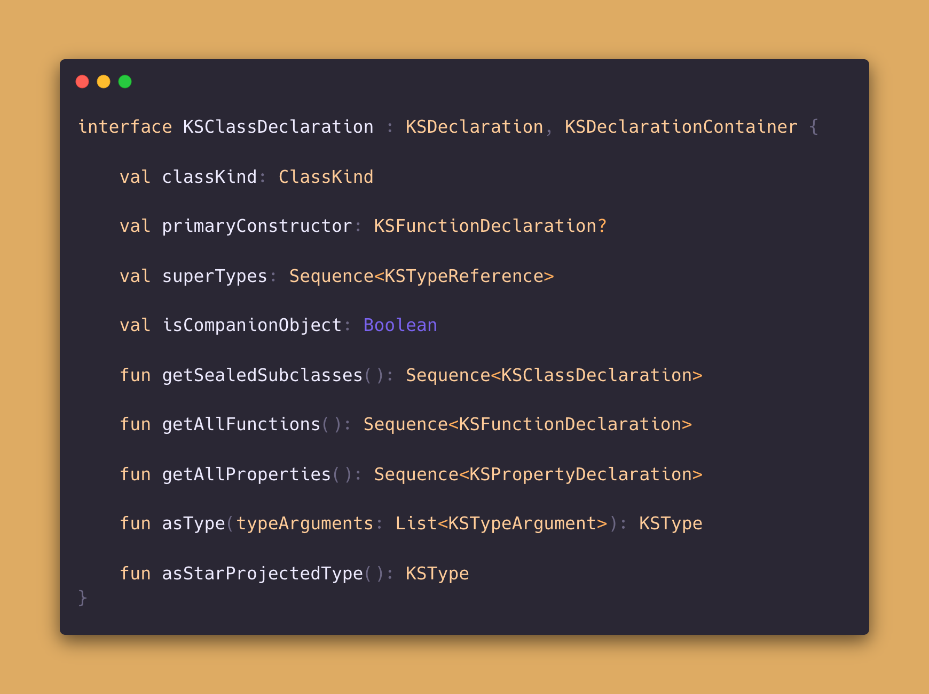
These properties can be used to analyse the class
Notes:
Both classes have been passed to the KSVisitor. For both classes visitClassDeclaration got called.
This enables us to check on the following attributes of a class.
Using superTypes allowed us to find out the relation between Class and ClassImpl.
The classKind told us that the one class is an interface and the other is a class.
Using getAllFunctions enables us to figure out which functions belong to the class.
Playing around with this makes fun and is quite interesting. It shows a few insights which are not obvious in the beginning. I will share them with you!

Slide 9
Can you add
Configuration please
Ok.

Slide 10
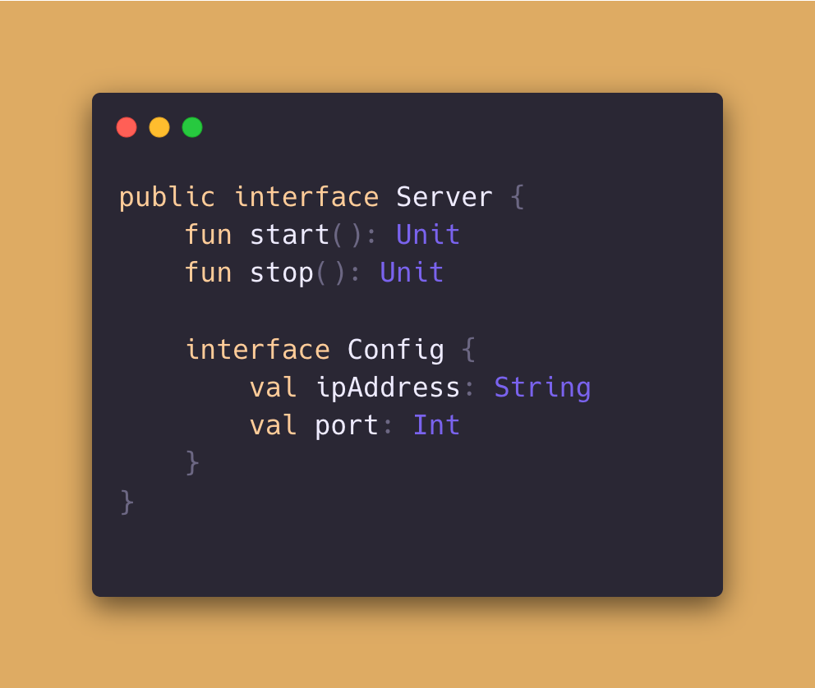
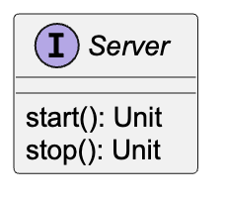
Generated
Documentation
Notes:
Config is not shown in the Plantuml Diagram (When I started the project)

Slide 11
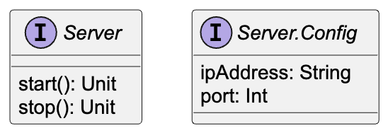
Expected
Generated
Documentation

Slide 12
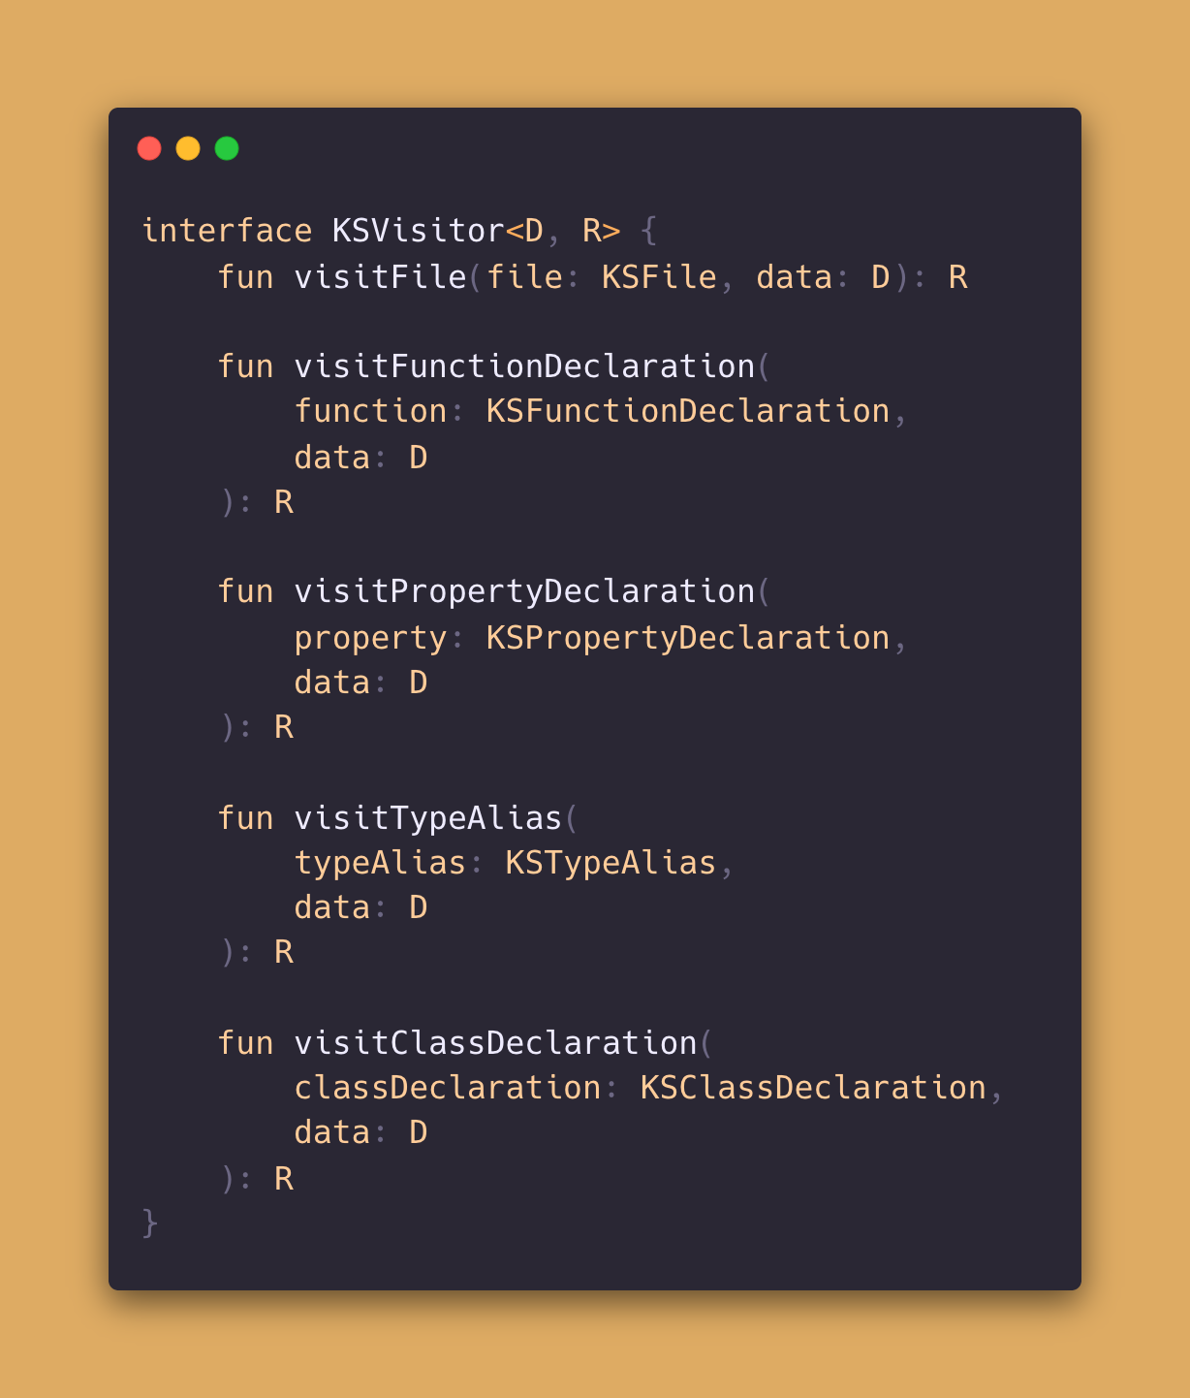
Why is the inner class missing ?
The Visitor is applied to the given File
and its nodes
The inner class Config was not visited
If a node has further nodes that should be visited, the visitor must be passed within the node
Notes:
In this case, the error lay in my interpretation of KSVisitor or in the expectation.

Slide 13
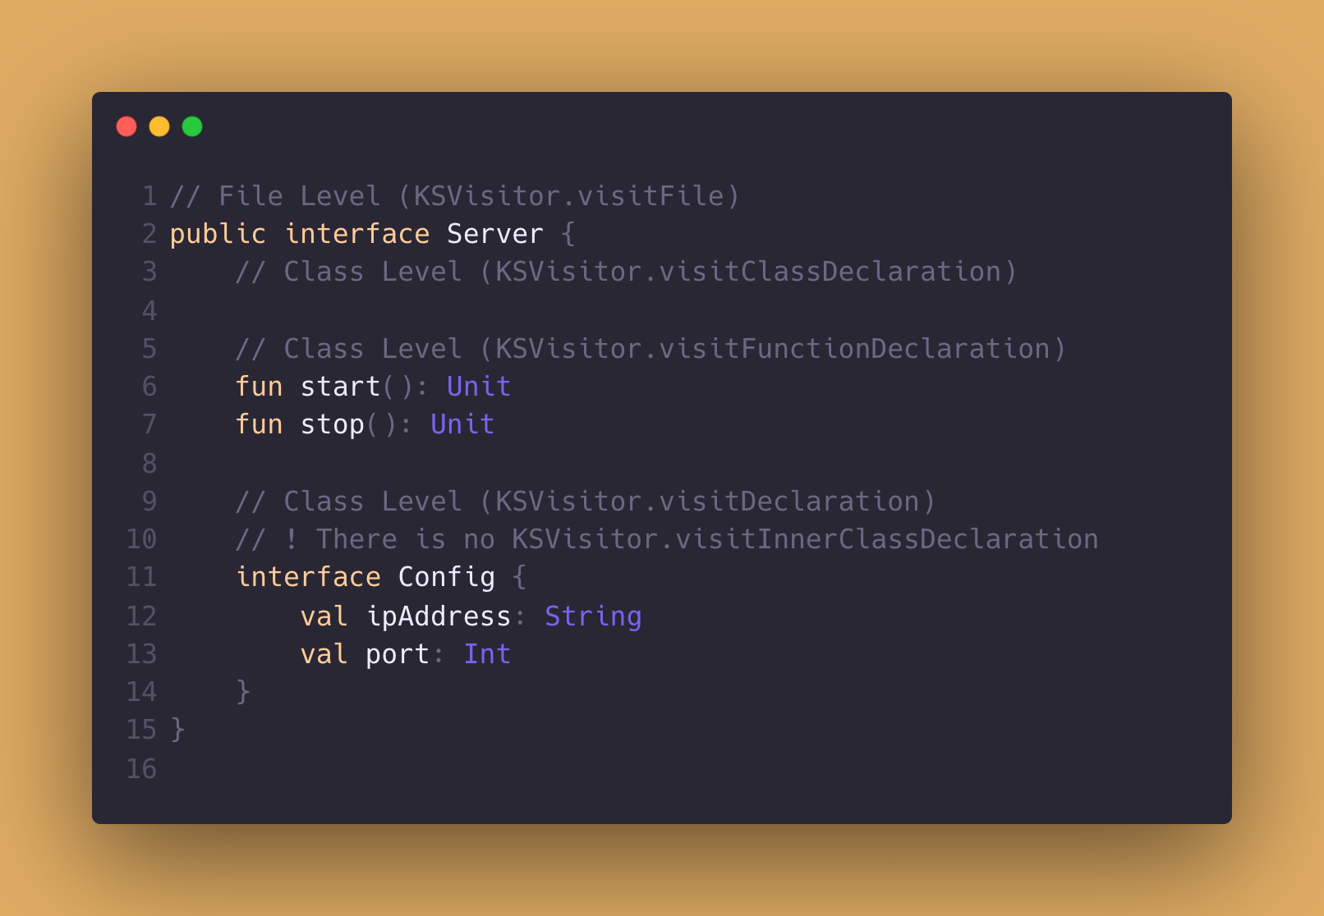

Slide 14
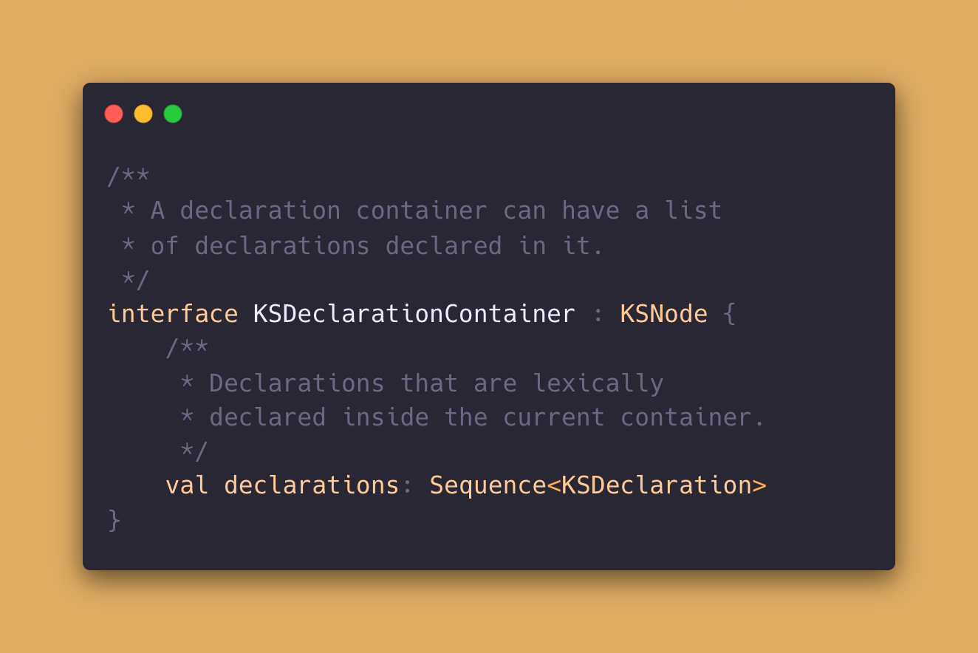
But to access the inner classes, declarations must be used

Slide 15
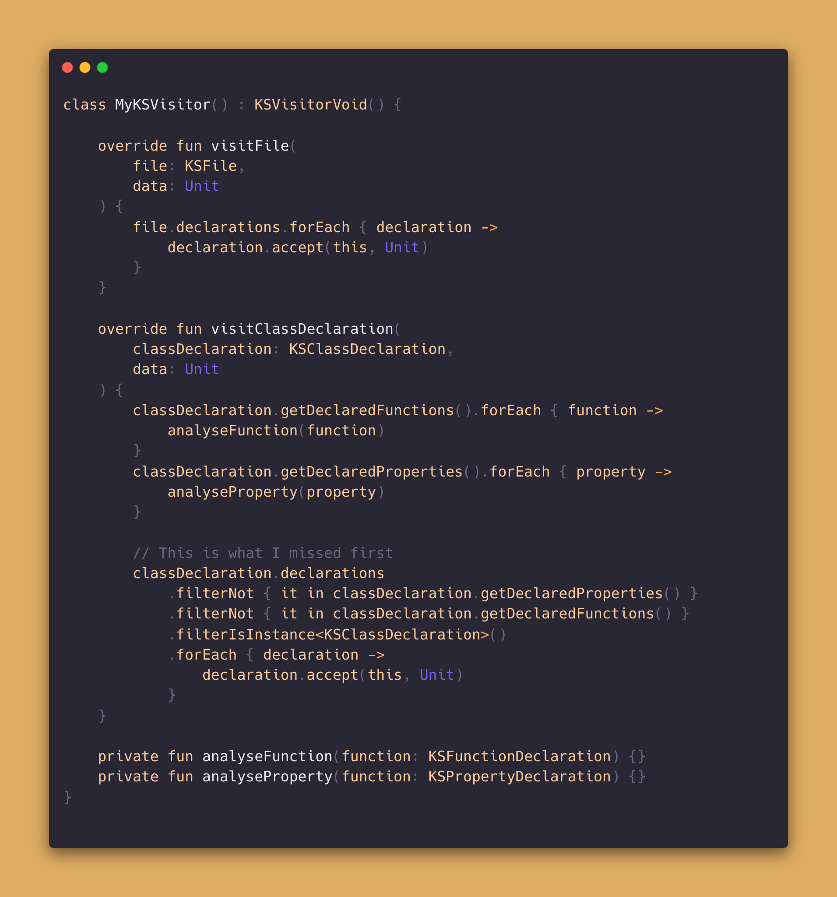

Slide 17
File
Server
KSFunction
KSProperty
Declarations
start
stop
start
stop
Config
KSFunction
KSProperty
Declarations
ipAddress
port
ipAddress
port
Level 0 Visitor
Level 1 Visitor

Slide 18
Advice 1
KSVisitor just visits the next level.
Pass it through to catch all levels

Slide 19
Advice 2
Inner Classes, Interfaces, companion objects can be retrieved by the declarations property
declarations contains every KSDeclaration, not only the ones for inner classes etc.
Understand the KSClassContainer component

Slide 20
Advice 3
Understand the KSClassDeclaration component
It provides superTypes (parents)
It provides allFunctions
It provides allProperties
It provides its classKind

Slide 21
Almost, I will add Default config
Done ?

Slide 22
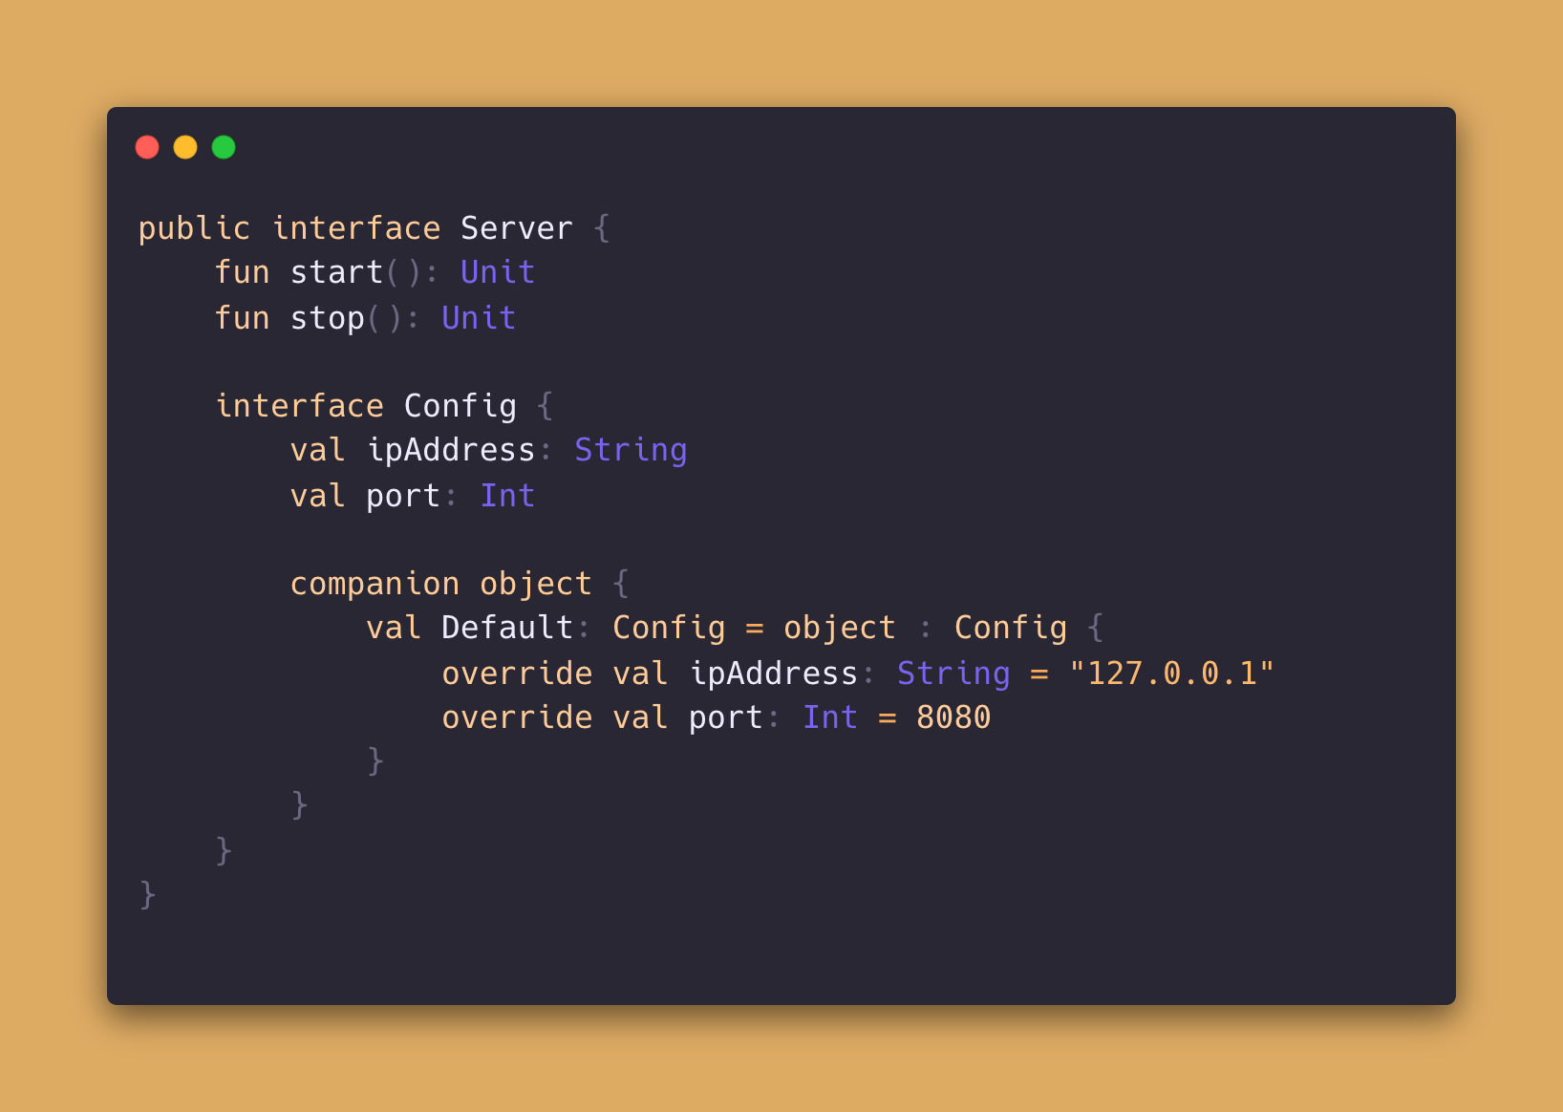
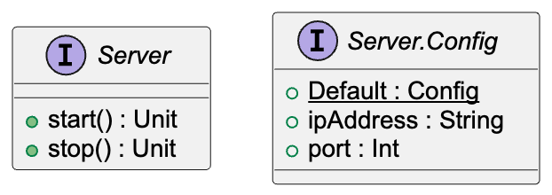

Slide 23
File
Server
Declarations
Config
Declarations
ipAddress
port
start
stop
companion object
DEFAULT
Level 0 Visitor
Level 1 Visitor
Level 2 Visitor

Slide 24
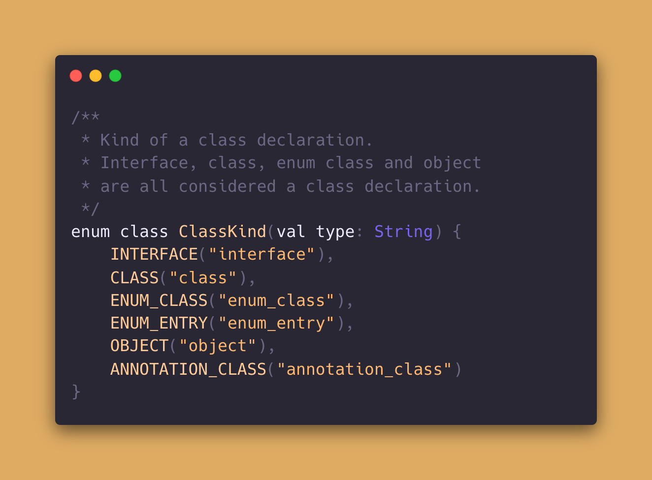

Slide 25
Advice 4
Know the KSClassKind enum states

Slide 26
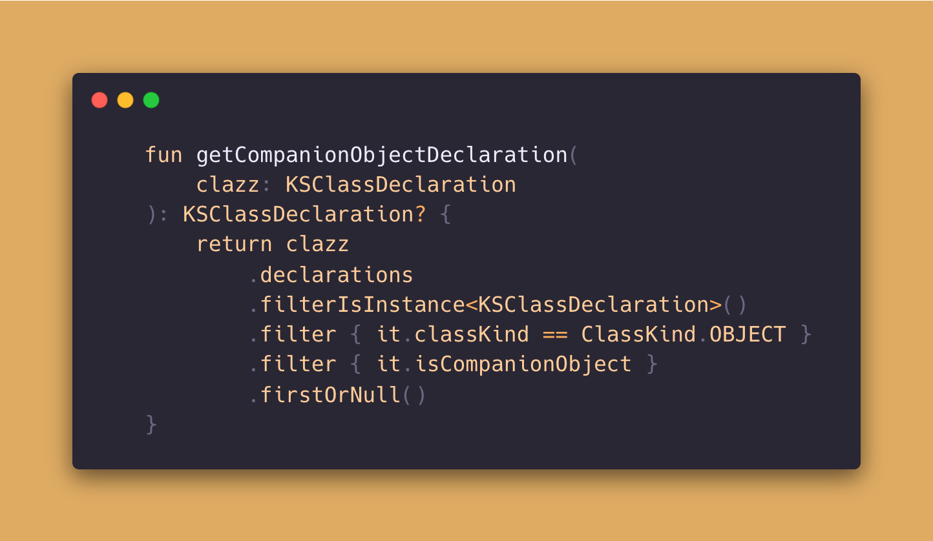
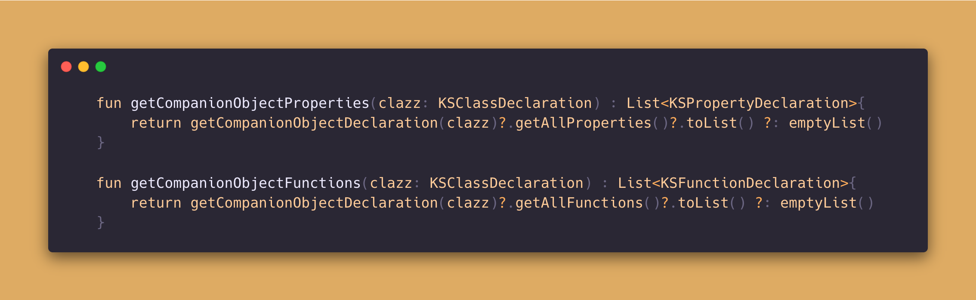

Slide 27
Advice 5
Every class can have max. 1 companion object
All functions and properties of this a companion object can be intepreted like Java static
To find the companion object of a class, use declarations and filter on the Object classKind + KSClassDeclaration isCompanionObject property

Slide 28
Can you add a State so I can see if the server is Running ?
Sure

Slide 29
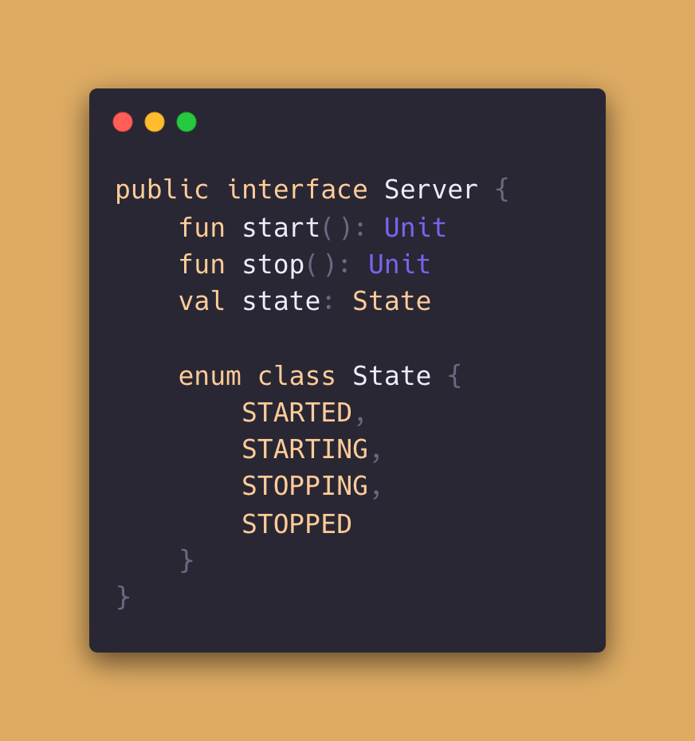
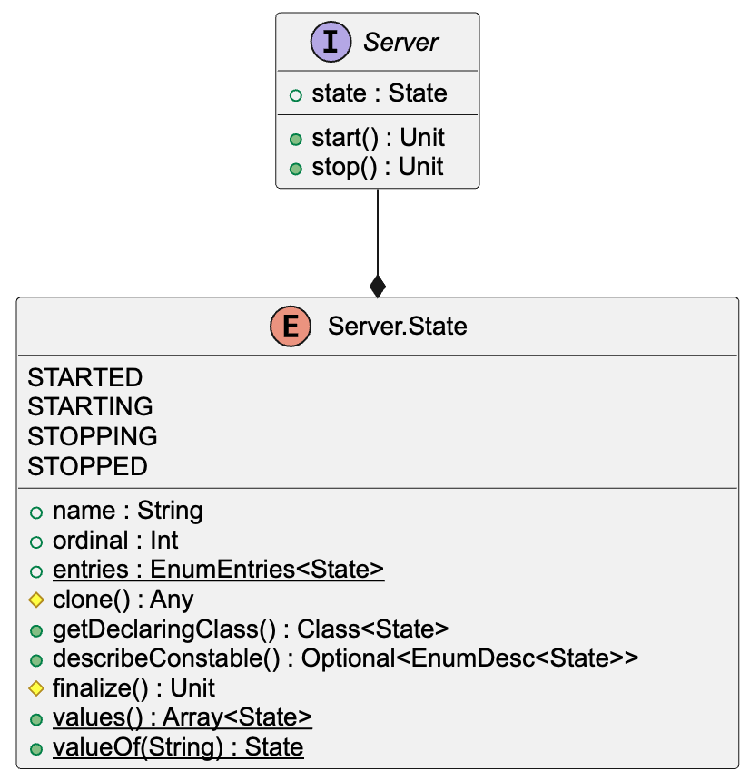

Slide 30
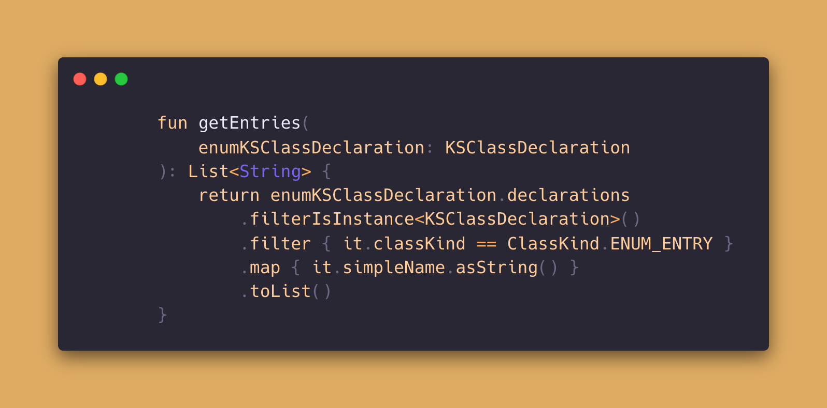

Slide 31
Advice 6
Each Enum has a superType: Enum <T>
Enum entries can be retrieved by the EnumEntry classes in its declarations

Slide 32
Yesterday it got turned off, but I have no Idea why, can you add that to the State ?
Sure

Slide 33
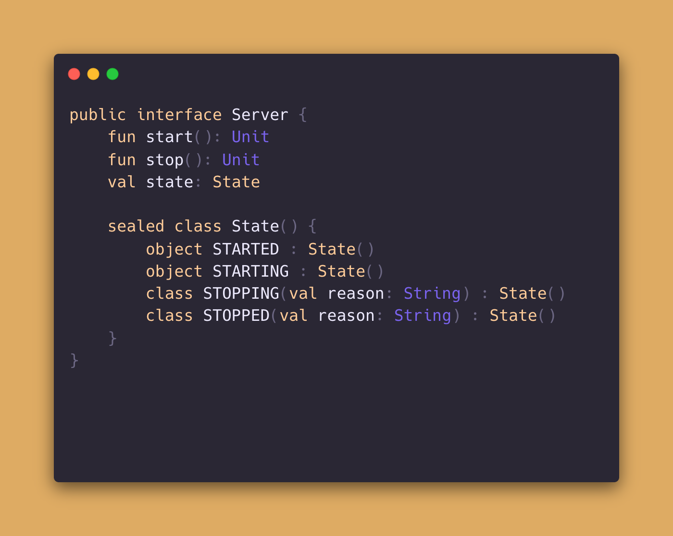
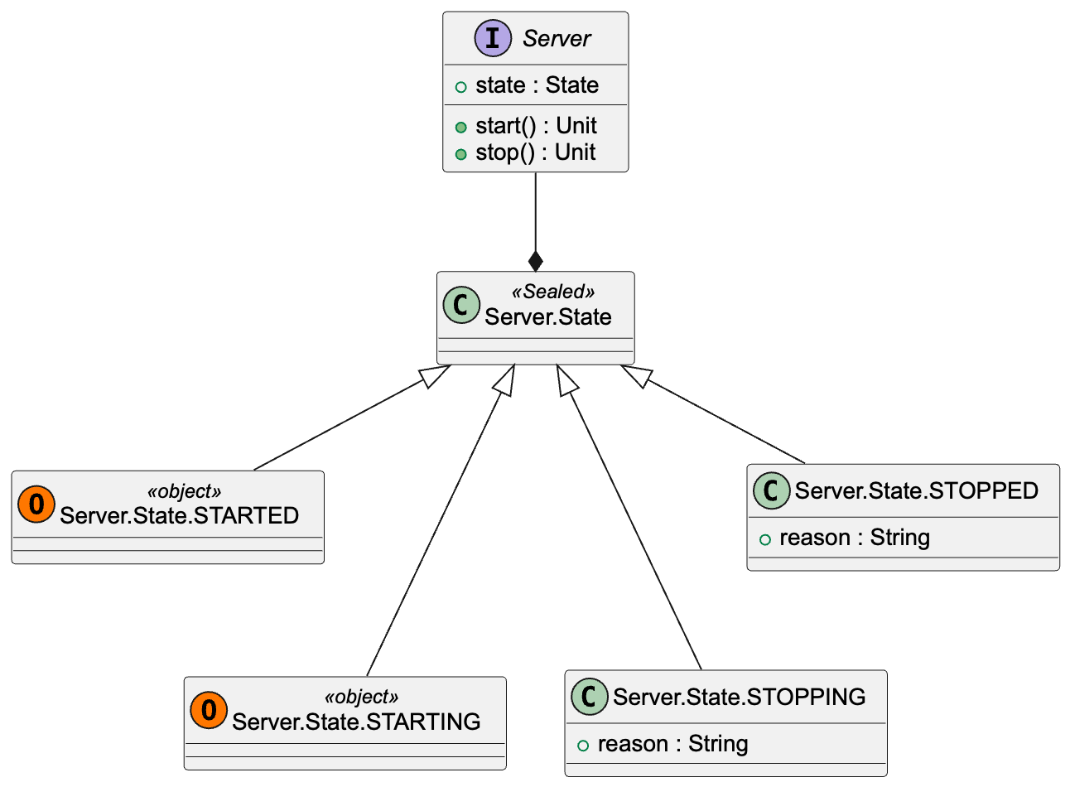

Slide 34
Advice 7
A sealed class can be identified by the modifiers property
Sealed classes can be interpreted like a group of classes that inherit a shared parent class

Slide 35
Do you mind if we do internally ?
If not I will provide an TypeAlias !
We dont say Config anymore. We call it Properties now.

Slide 36
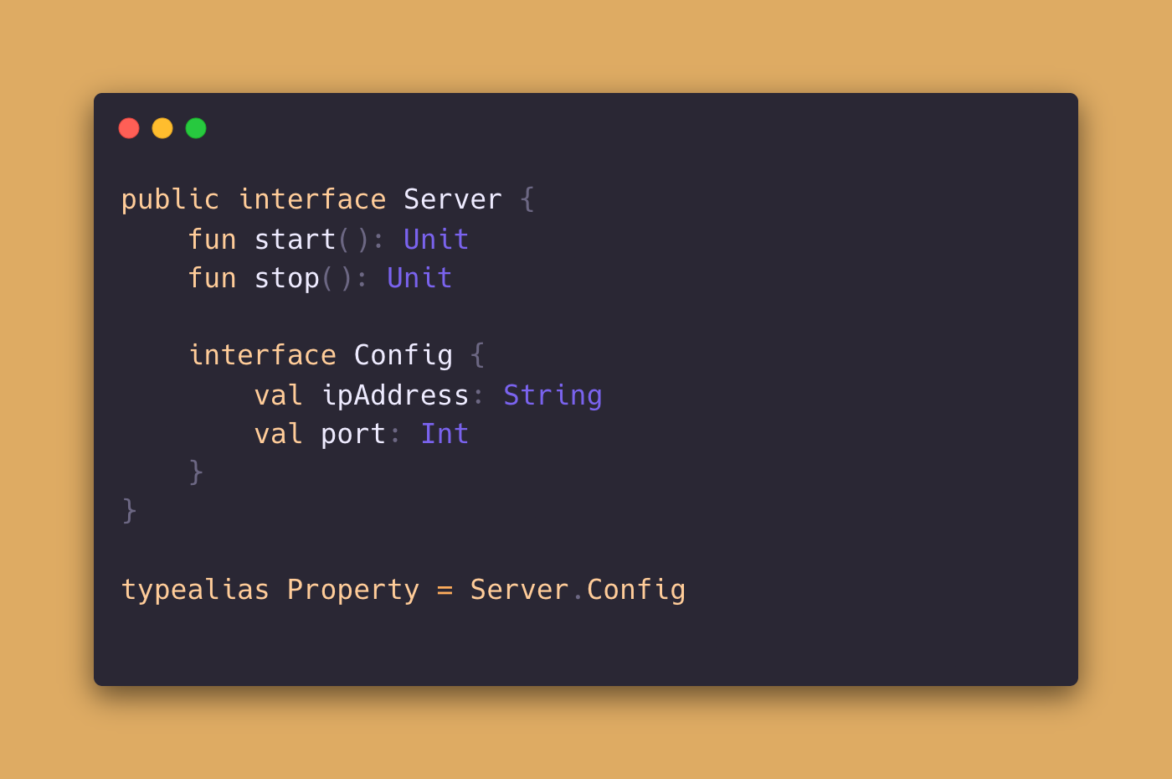
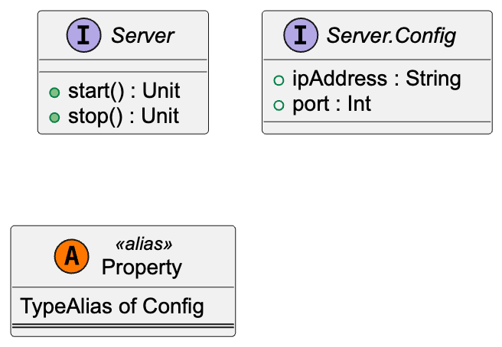

Slide 37
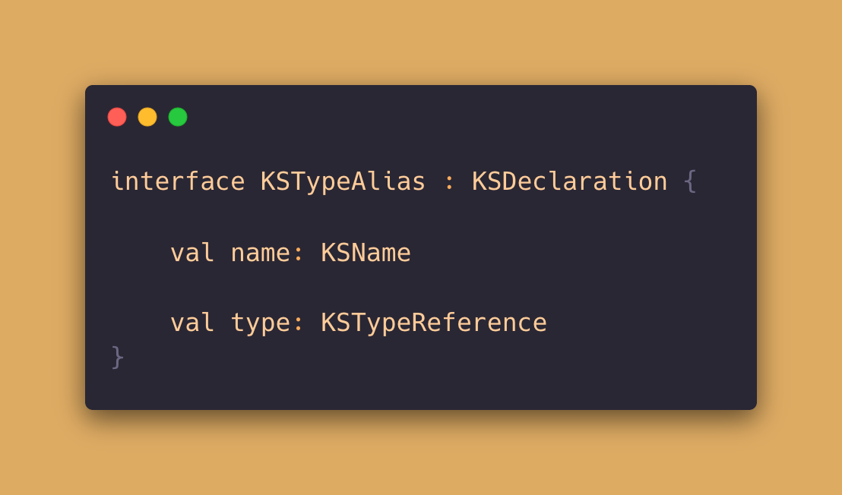

Slide 38
Advice 8
Typealias are not KSClassDeclarations
Extension functions can be applied on TypeAlias

Slide 39
The other
team mentioned, you only provide an Interface. Can you show me how you implement the server internally ?
Ok I‘ll try

Slide 40
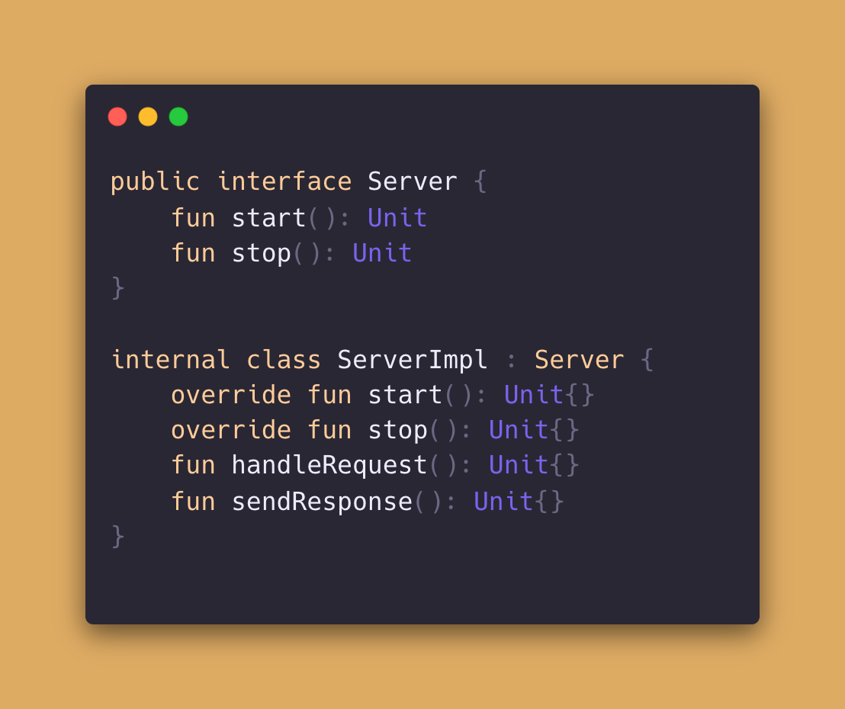
Expected
Generated
Documentation

Slide 41
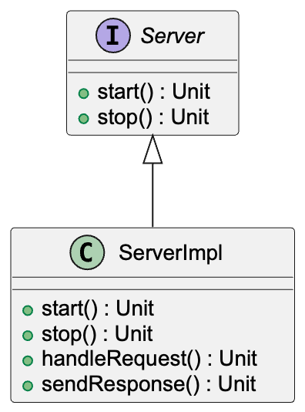
Actual
Generated
Documentation

Slide 42
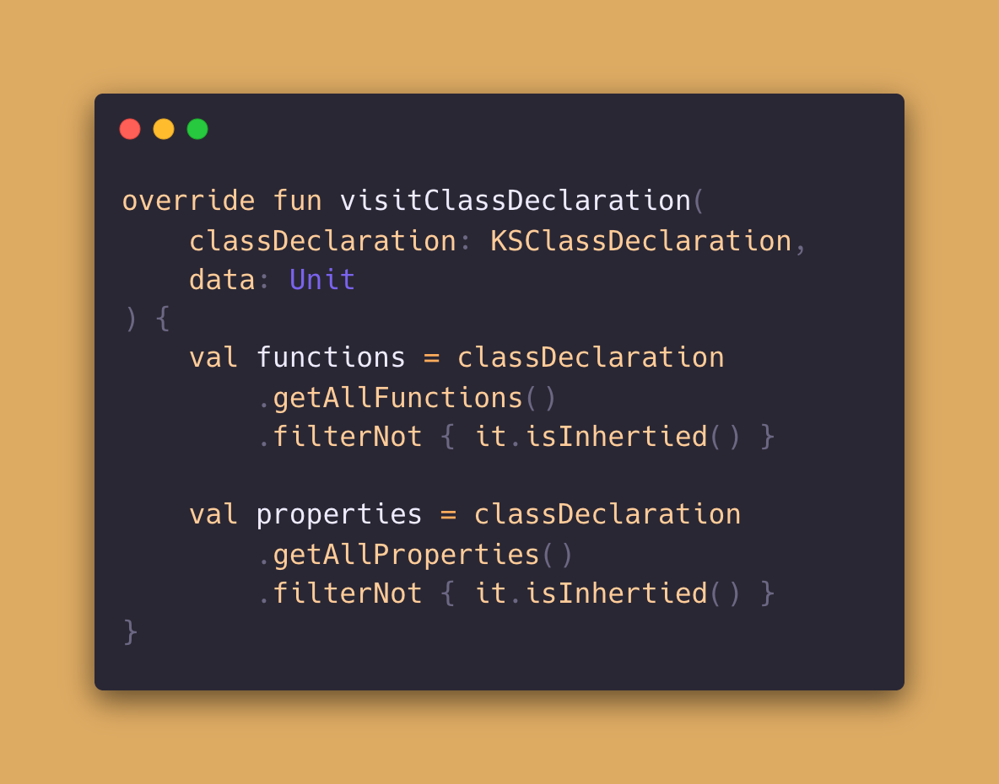
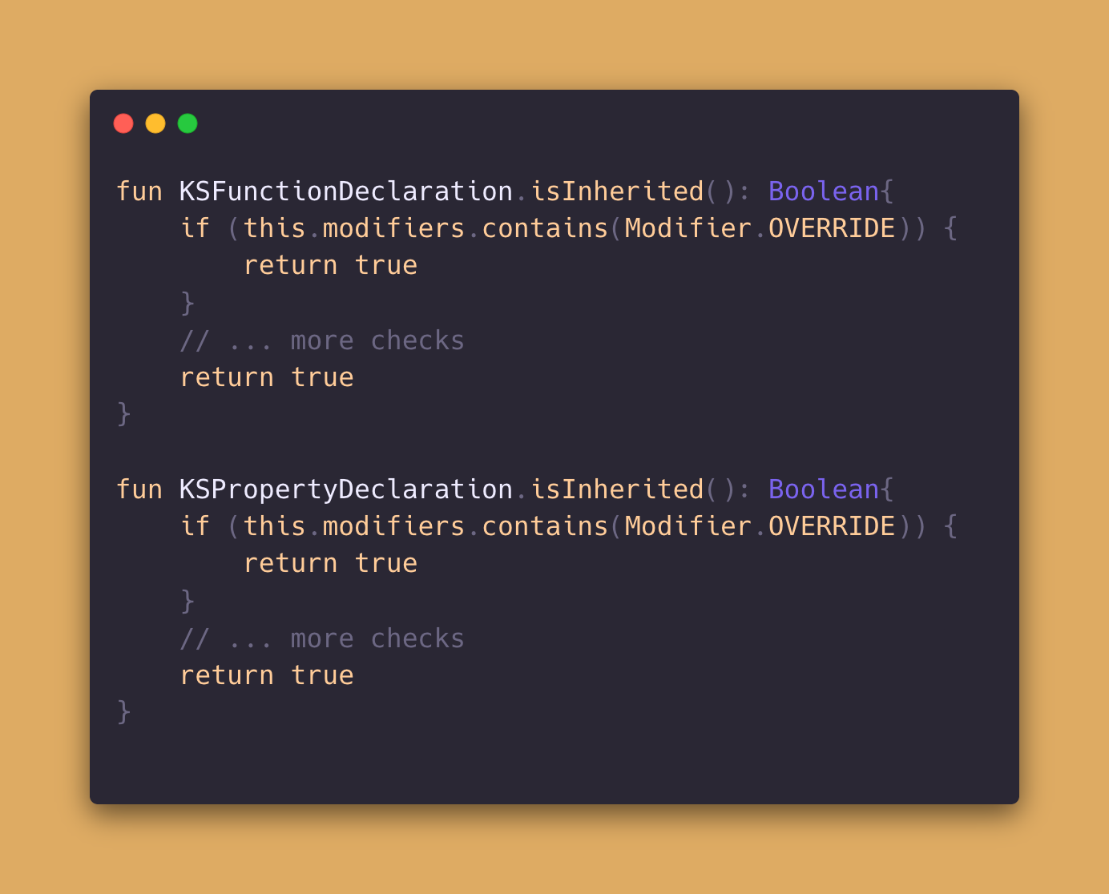

Slide 43
Advice 9
To find the functions that are provided by a parent interface, the modifier can be checked
If the parent is an abstract class, the override modifier might not be present

Slide 44
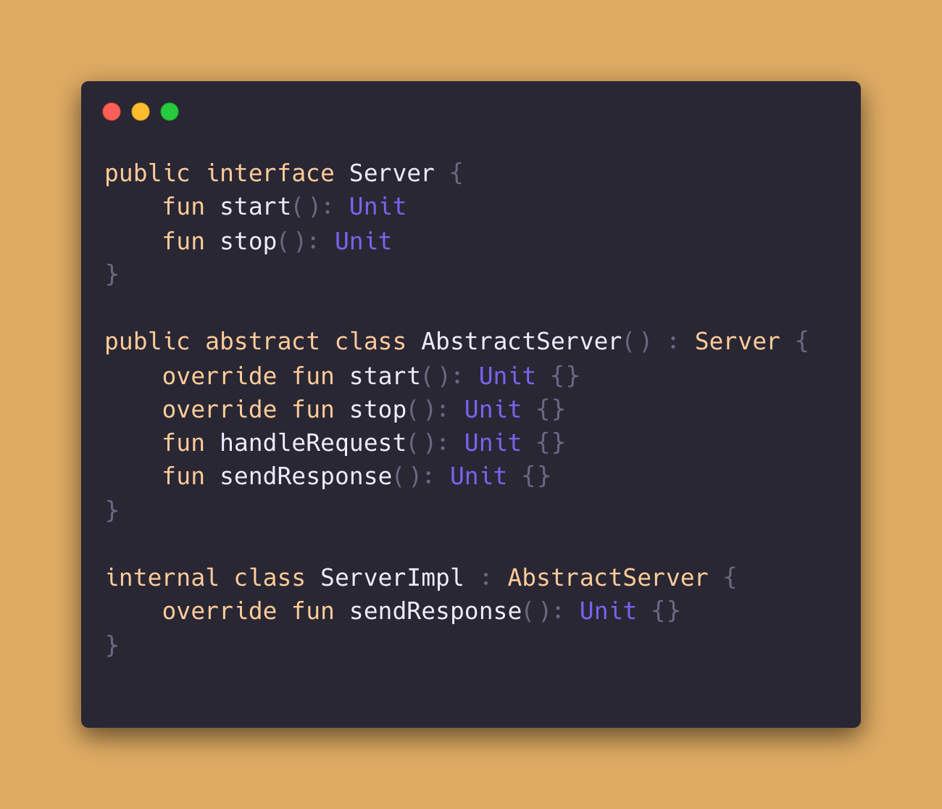
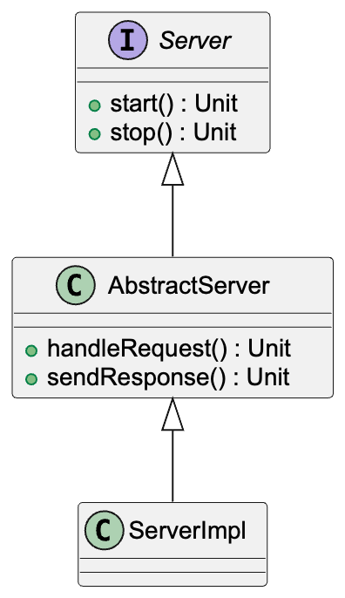
Expected
Generated
Documentation

Slide 45
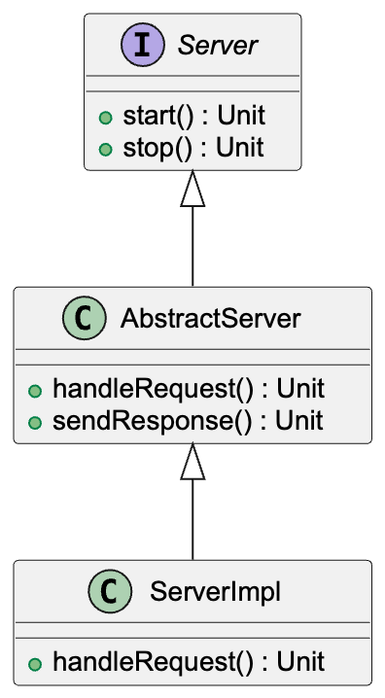
Actual
Generated
Documentation

Slide 46
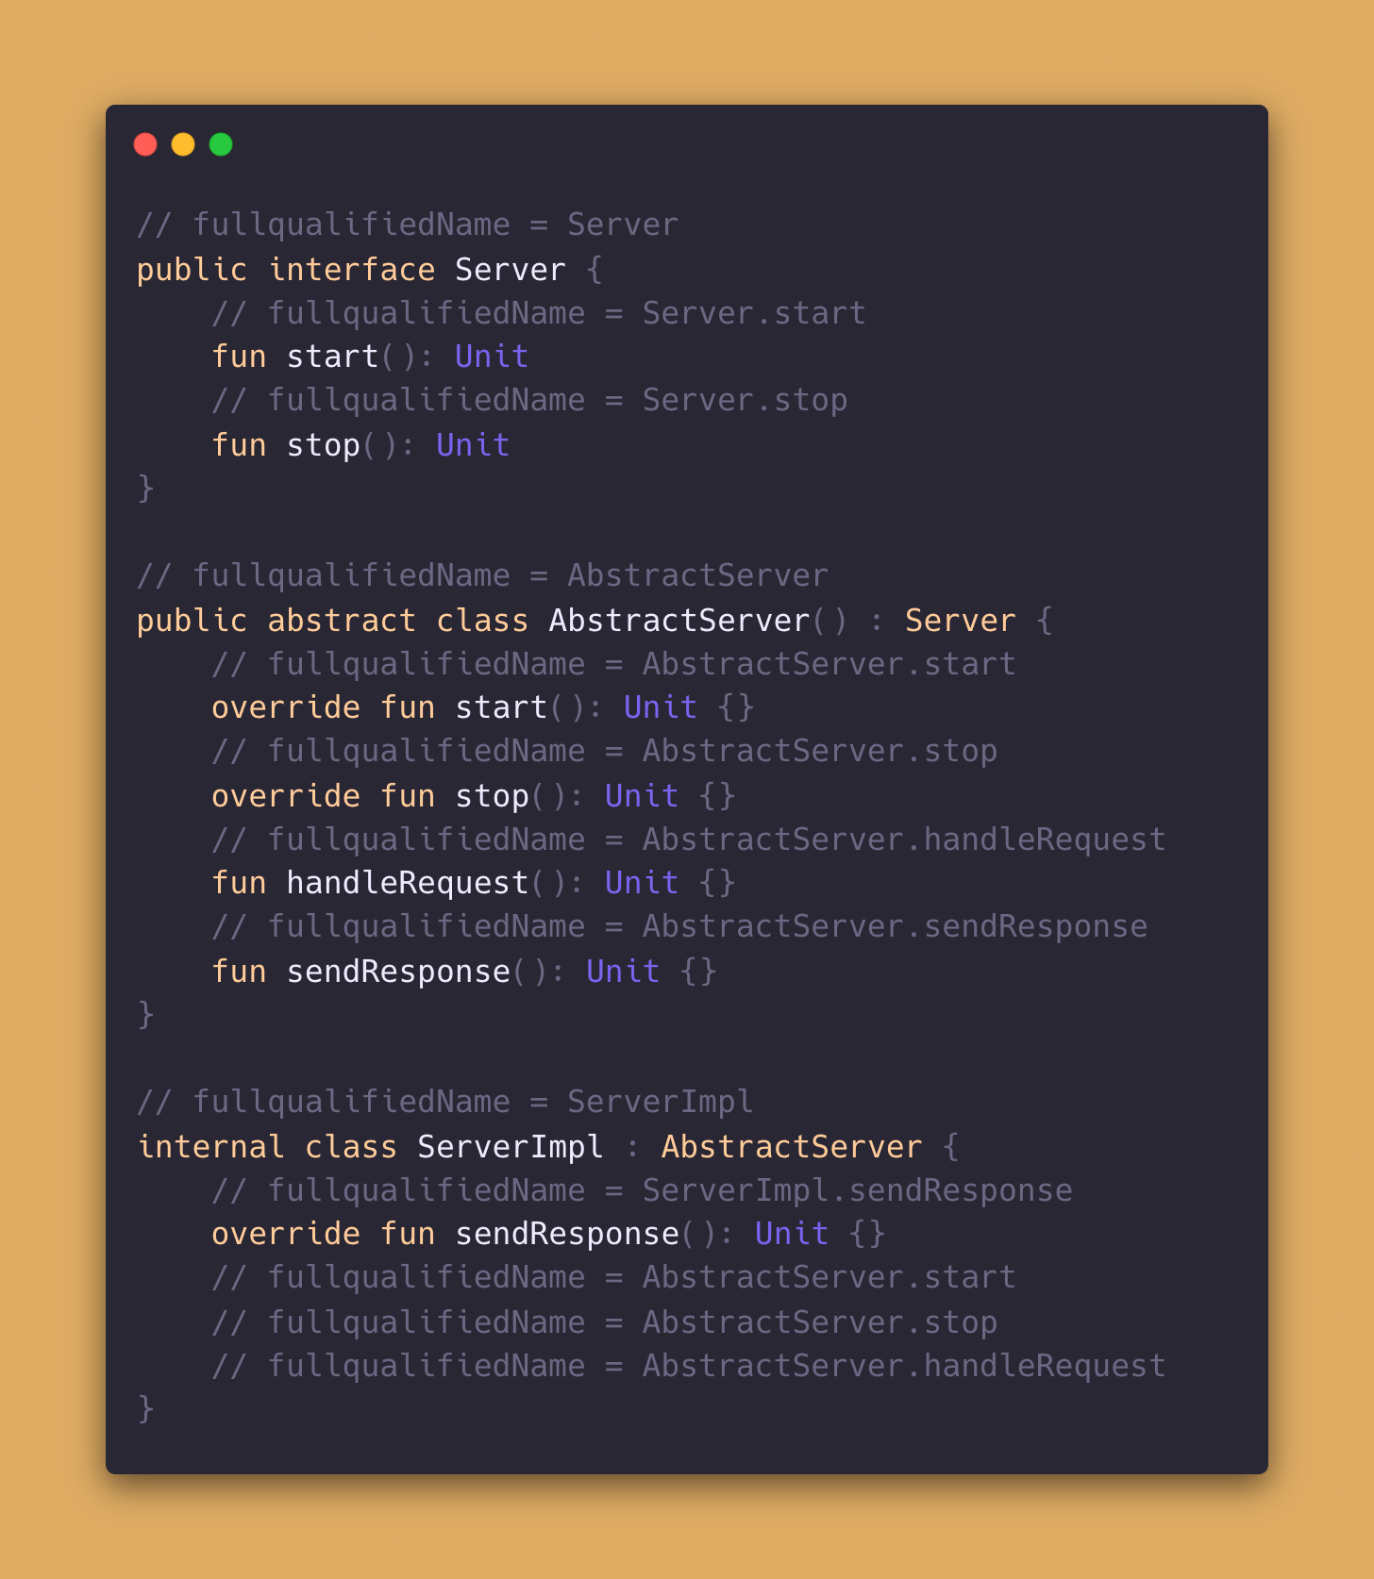
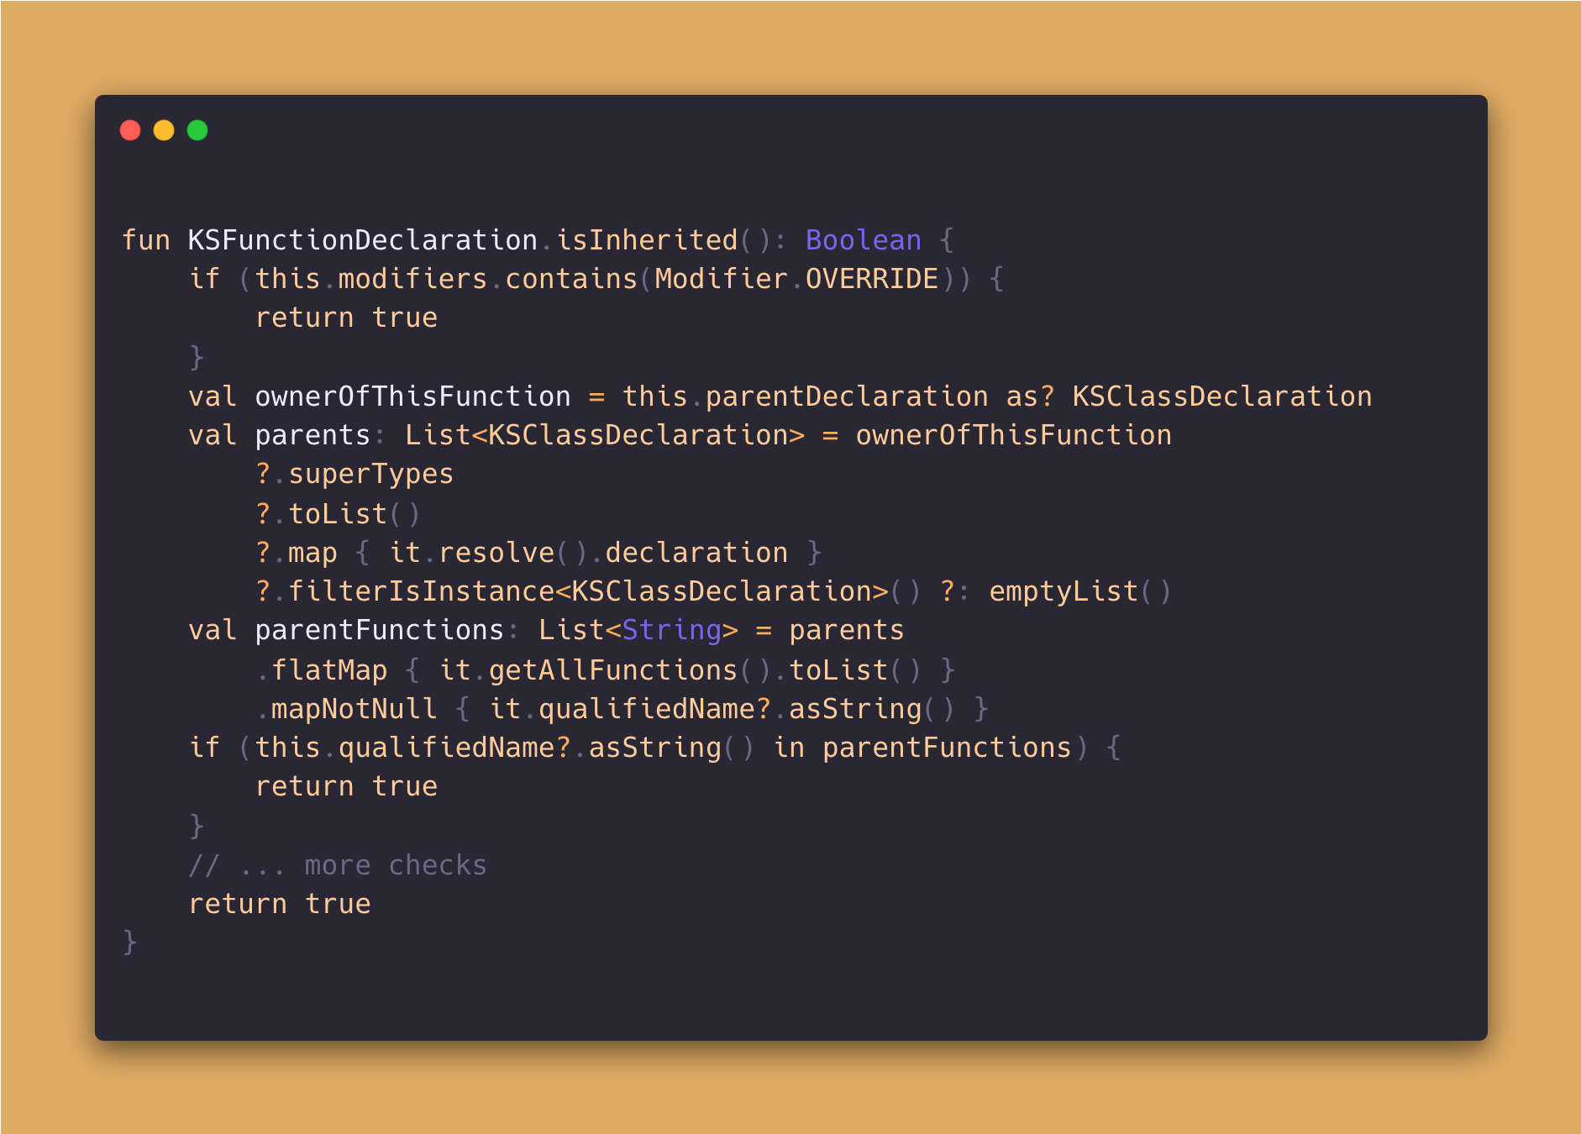

Slide 47
Advice 10
To find the functions that are provided by a parent class, the full qualified name can be compared

Slide 48
Btw. The
other Team added an extension function on your Server. Depending on the Server state the have a property „isRunning“.
…

Slide 49
Ahh one more thing:
We would love to see what Requests have been received and what Responses have been sent
I thought so already.

Slide 50
Thank you.
But you only know the half of the story
Amazing

